Slide 1
MEDICAL STORE BILLING SYSTEM
Presented By:
1) Anmol Mahajan 2) Gursharan Singh
3) Gurpreet Singh 4) Jasmeet Kaur

Slide 2
INTRODUCTION
Medical Store Billing System is a software for medical store billing and accounting. Built with latest advance technology, it supports all new version of Operating systems like windows, . This is the best available software for Pharmacy Management, Pharmacy Billing, Medical retail shop stock report generation and supplier report generation.

Slide 3
SYSTEM REQUIREMENTS
WINDOWS 7,8, 8.1 or 10 OPERATING SYSTEM (x32 / x64 BIT)
2 GB RAM MINIMUM
250 GB HARD DISK
PRINTER

Slide 4
TECHNOLOGIES USED
FRONT END :
JAVA / JRE v1.8
NETBEANS
BACK END :
DERBY

Slide 5
FEATURES
LOGIN PAGE
ADD/EDIT SUPPLIERS
REPORT GENERATION
BILLING
USER SETTINGS

Slide 6

JAVA AS FRONT END
Java is a high-level programming language originally developed by Sun Microsystems and released in 1995. Java runs on a variety of platforms, such as Windows, Mac OS, and the various versions of UNIX. This tutorial gives a complete understanding of Java. This reference will take you through simple and practical approaches while learning Java Programming language.

Slide 7

DERBY AS BACK END
Apache Derby, an Apache DB subproject, is an open source relational database implemented entirely in Java and available under the Apache License, Version 2.0. Some key advantages include: Derby has a small footprint -- about 3.5 megabytes for the base engine and embedded JDBC driver.

Slide 8

LOGIN PAGE
To start the application user has to enter their credentials.
Due to security reasons login page is necessary so that authorized person can see the billing software.

Slide 9
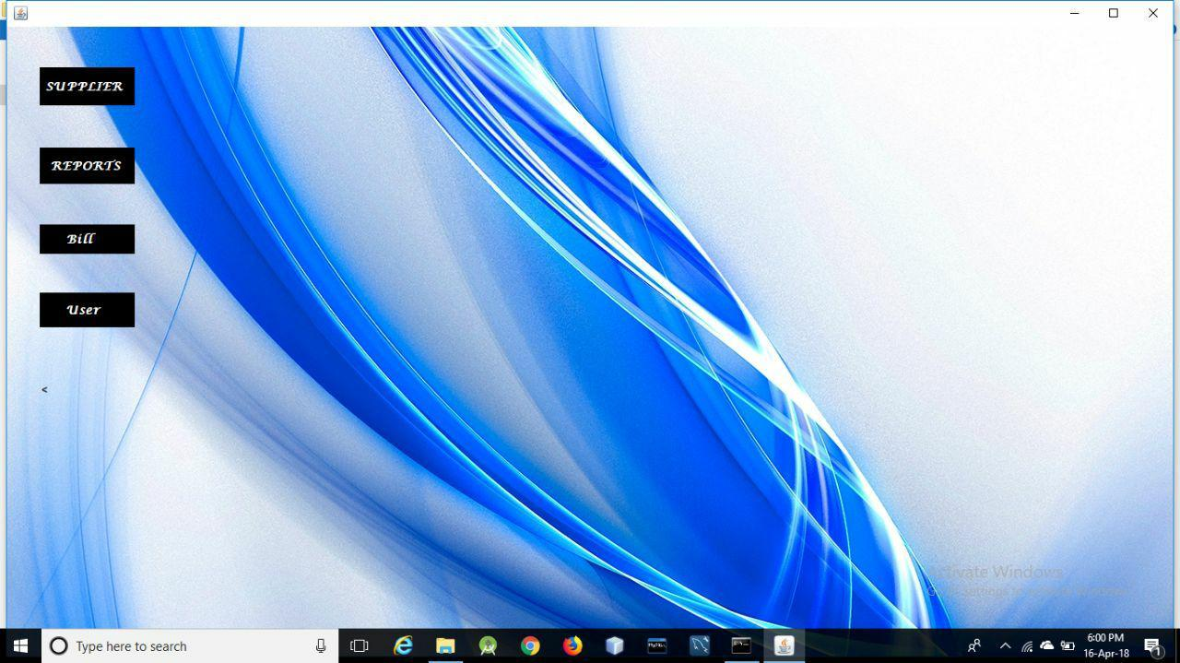
NAVIGATION PAGE
Navigation page allows the user to choose among the features of the product are
Supplier : Add/ Edit suppliers of the store owner.
Reports: to search or generate reports of stocks sold.
Bill: to generate bills.
User: to reset login password or to logout.

Slide 10
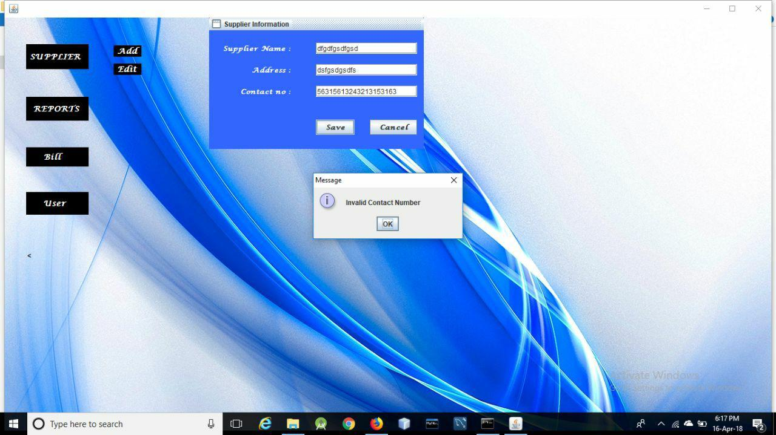
SUPPLIER PAGE
This page allows user to add supplier.
Error will be pop up in case any field left blank or inappropriate value filled.

Slide 11
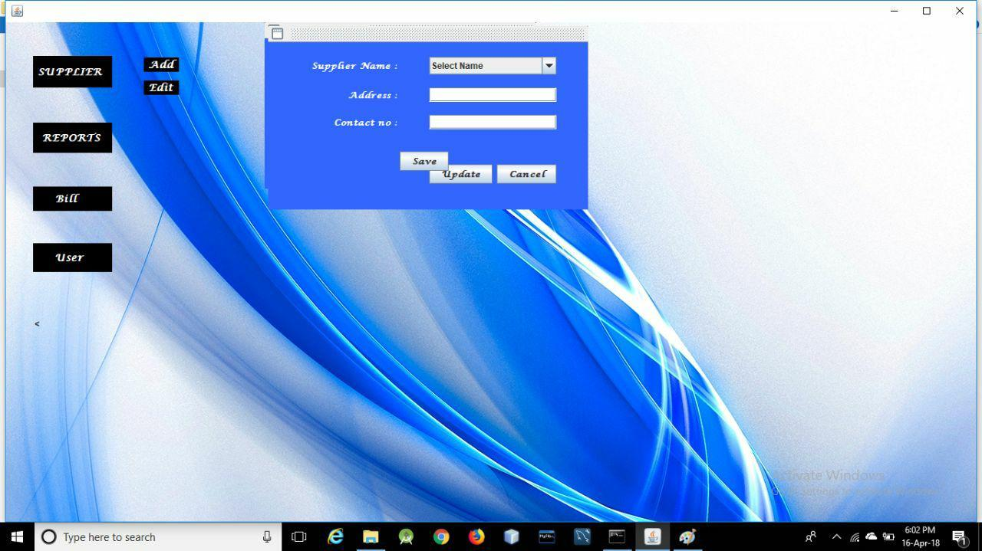
SUPPLIER EDIT PAGE
This page allows user to edit supplier details.
User can search respective supplier name from the drop down.

Slide 12
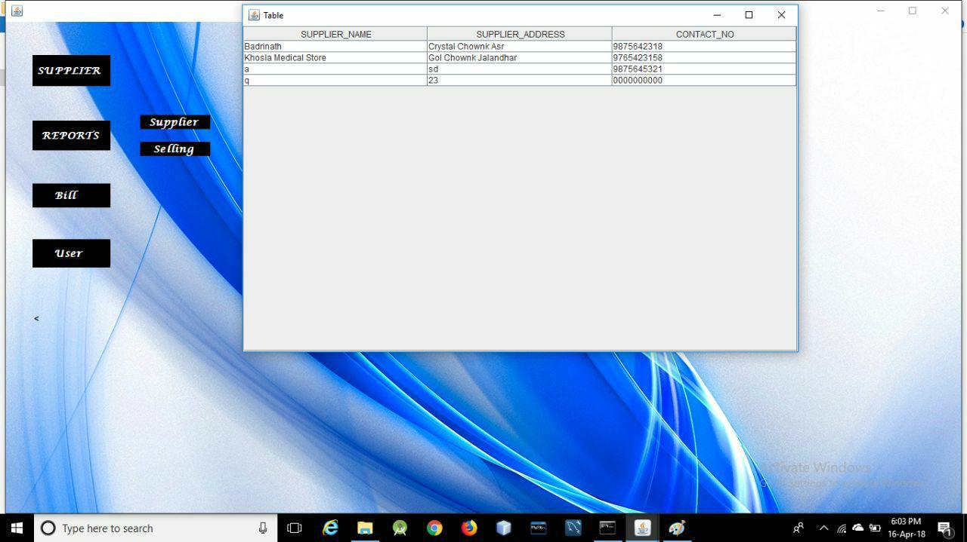
REPORTS
This page shows reports of the suppliers along with their contact details.

Slide 13
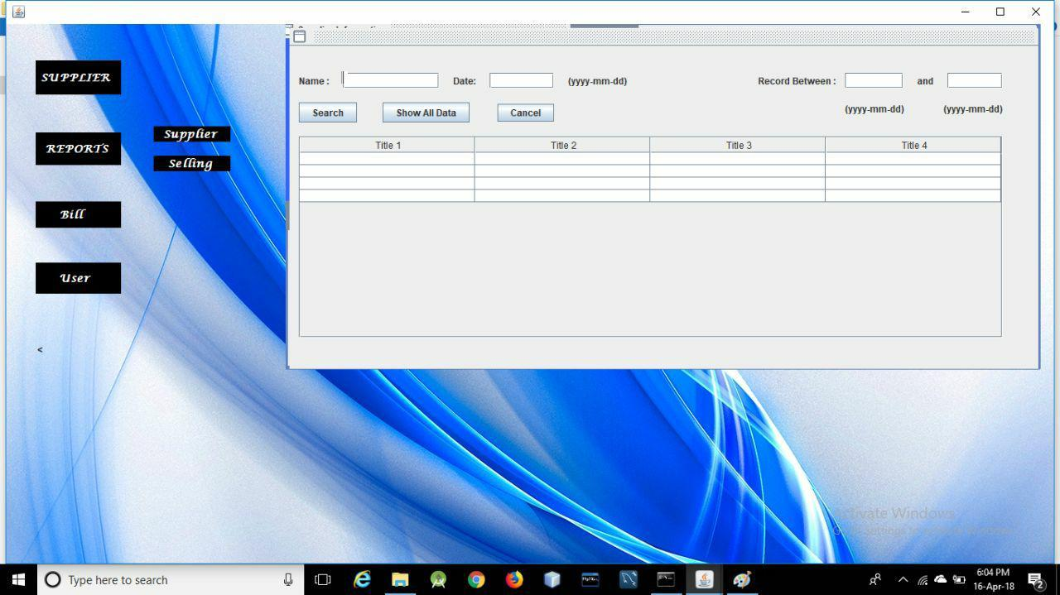
SELLING REPORT
This shows all the bills generated till date.
User can search it on the basis of customer name, date or for specific period.

Slide 14
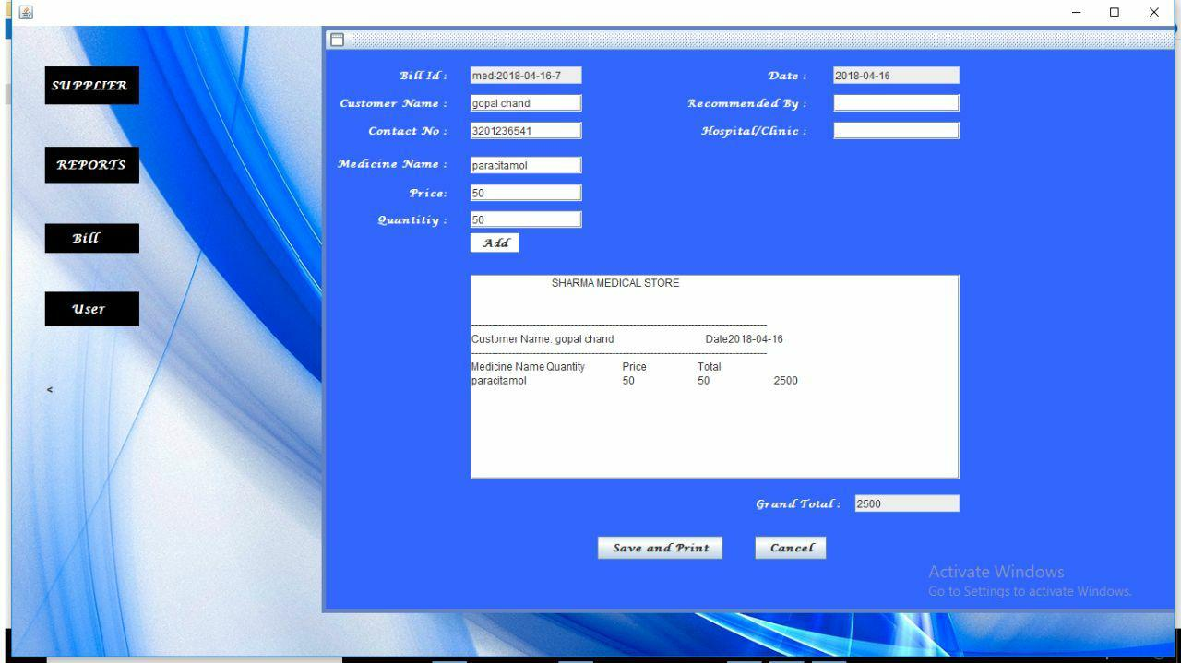
BILLING PAGE
User can generate bills by adding products along with their quantity and price. It will calculate total price.
Allows user to save bill as PDF.
User can also print the generated bill.

Slide 15
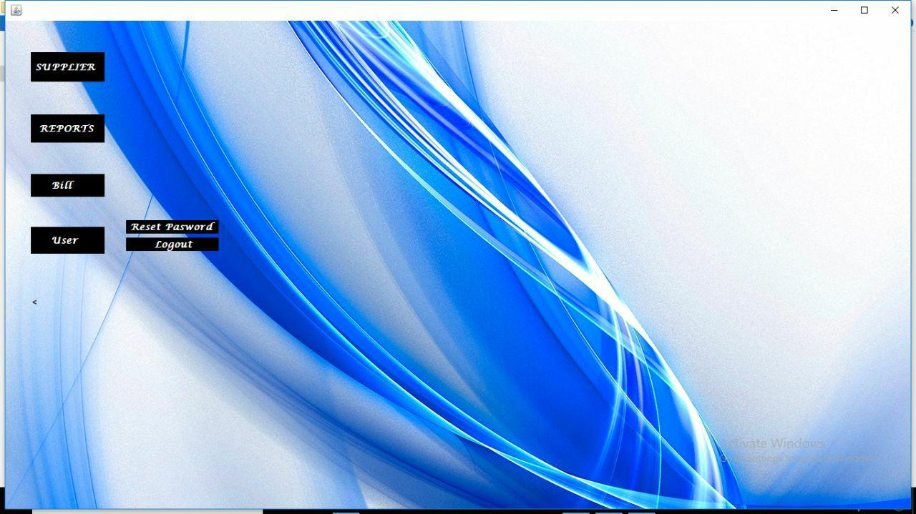
USER BUTTON
User button provides two features:
Allows user to reset login password.
To logout from current session.

Slide 16
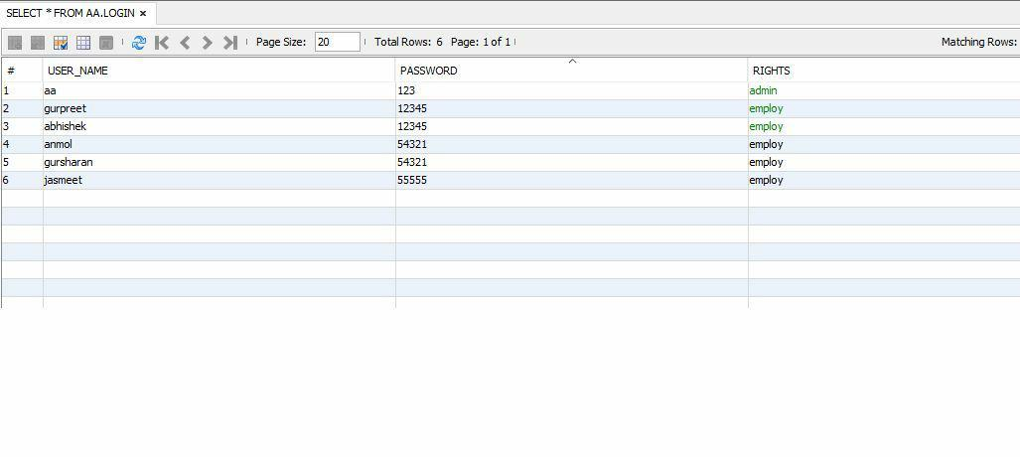
CUSTOMER TABLE
User table where it displays details of authorized user. It contains name, username, password and rights.

Slide 17
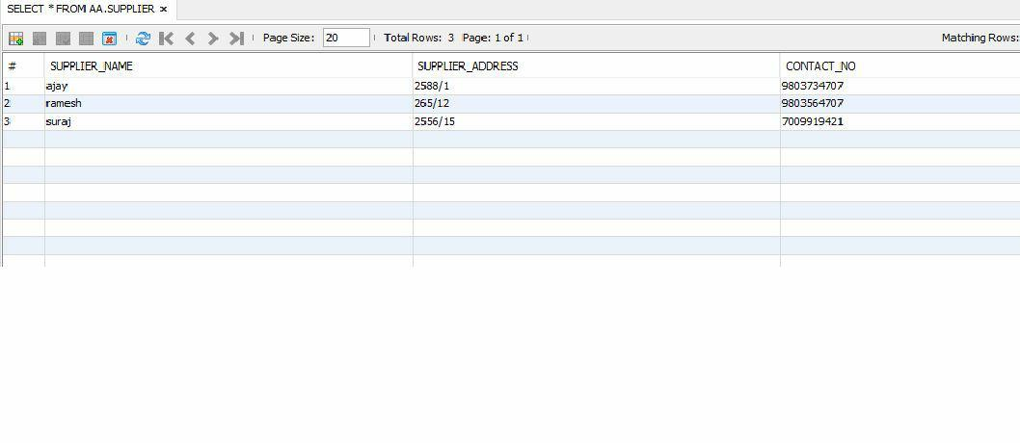
SUPPLIER TABLE
Supplier table shows the detailed list of suppliers along with their contact details.

Slide 18
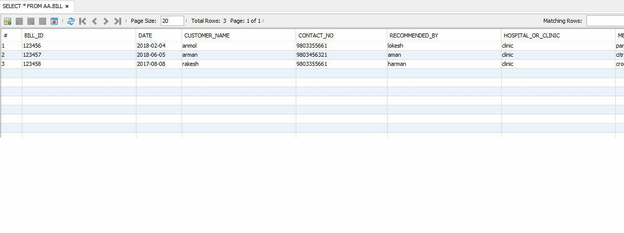
BILL TABLE
Bill tables shows the list of all the generated bills till date. It includes bill id, date, customer name, contact no, recommended by, hospital/ clinic etc

Slide 19
THANK YOU
GURSHARAN
SINGH
JASMEET KAUR
GURPREET SINGH
ANMOL
MAHAJAN

